Slide 1
Day 1 (MM/DD/YYYY)
D-Code

Slide 2
Welcome!

Slide 3
Today’s Goals
Meet the Team
Discuss our goals
Discuss our workflow
Craft our team agreement
DEV TIME!

Slide 4
Who are we?

Slide 5
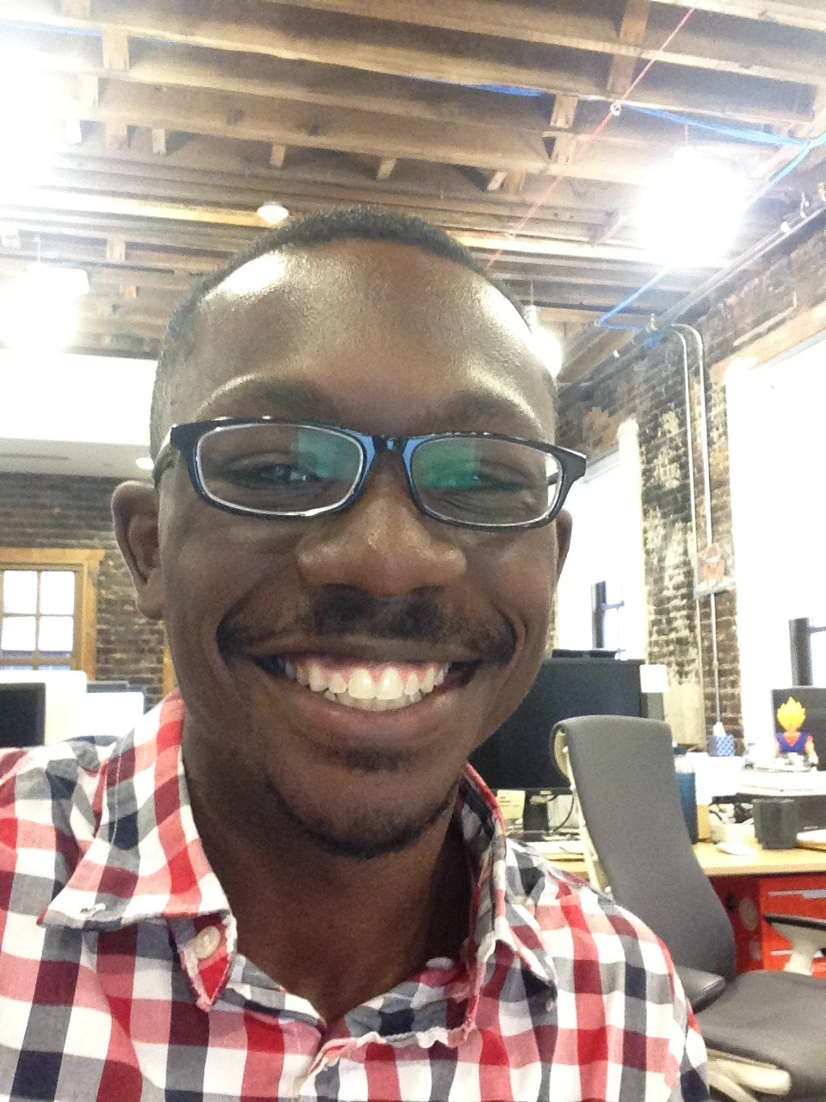
Kyle
Grew up in a town called Wooster, Ohio
Enjoy traveling, learning about different places (cities, states, countries...)
Studied Economics and Chinese at Princeton University in New Jersey
Like cereal more than some people think a man my age should (Trending: Honey Bunches of Oats)
Favorite musician right now is Maître Gims (from Paris)

Slide 6
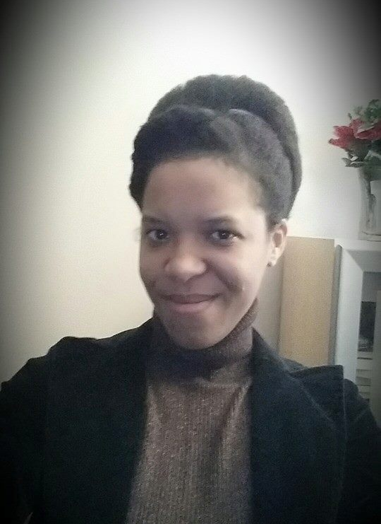
Brandy
Writer of Code (Java)
Writer of Words (Poetry)
Mom of two small humans
Detroit Born and Raised
Halo Mistress Chief (Ubisoft)
Reader of Sci-Fi
Part Android

Slide 7
Programmable Introductions
var introLoop = function(){
while(factJar.length > 0){
var fact = factJar.shift();
guessFact(fact);
} }
var guessFact = function(fact){
var guess = 2;
console.log(fact);
console.log(“Who do you think this fact belongs to?”);
if(guess > 0){
function raiseHand();
guess = guess - 1;
}
}
Notes:
Directions for participants: The first student will read the fact aloud, guess who it belongs to. Limit 2 guesses. Then owner identifies themselves and restates their name and fact. Team (Everyone) gets a point for every right fact guess. Then, pass the bag on to the next student.

Slide 8
Today’s Goals
Meet the Team
Discuss our goals
Discuss our workflow
Craft our team agreement
DEV TIME!

Slide 9
Why are we here?

Slide 10
Team Goals
Introduce you to the world of software development
Learn the basics of Javascript, HTML and CSS
Use what we learn to ship something cool

Slide 11
Why are you here?

Slide 12
Individual Goals
A software developer’s most important development is themselves.
Remember that there is always something new to learn and we should be willing to learn something new every chance we get.
You will never know everything…
but you can always google it.

Slide 13
Goal Map
Notes:
In this program, it’ll be clear that only you can make yourself get the knowledge you want. That should be maybe a little scary, but also empowering!
Have students record 3 goals for this class.
Have students record 3 apprehensions they have about meeting their goals.

Slide 14
Today’s Goals
Meet the Team
Discuss our goals
Discuss our workflow
Craft our team agreement
DEV TIME!

Slide 15
How will this work?

Slide 16
Procedures
Because this isn’t a formal class, it’s important that everyone understands how we are going to do things.
Lot of freedom in programming in general…but also tons of ways to get lost, confused, frustrated.
Good habits help individual programmers be successful; good procedures will help our class be successful.
Good analogy for programming, too.

Slide 17
Flow of Class
Review
Teaching & Exercise
Little bit of us talking or showing you a concept
Practice that concept on your own
Come back together, share and compare methods
Individual work time

Slide 18
Today’s Goals
Meet the Team
Discuss our goals
Discuss our workflow
Craft our team agreement
DEV TIME!

Slide 19
It’s like a contract… but collaborative
Notes:
Just want to go over this at a high level (not get lost in all the detail):
Purpose is to show how we want to work as a team, from values to particular processes.
For our purposes, most important thing is values; we’ll learn the processes as we go on.

Slide 20
Sample Team Agreement

Slide 21
D-Code Team Agreement
Some things to keep in mind while we’re crafting our agreement:
Working Agreements are social contracts that outline how we will work as a team.
While every single team member is vital to the whole, we succeed or fail as a unit.
Give your opinions respectfully and receive other’s with equal respect.
Notes:
We will hold ourselves to standard we come up with.
Value we would like to include: Respect, Integrity and the Right Effort (not just acting for action’s sake)…
Time Commitment / Availability
We will be present each scheduled class.
We will be focused on our learning materials for that day.
If we know we will be absent we will let our team know.
Communication and Teamwork
We will communicate with respect to everyone.
We will give and receive constructive feedback.
We will get input from team members before making decisions that affect the team.
Effort
We will do our best to meet our deadlines.
If we cannot meet our deadlines, we will give our team members enough advance notice.
Coding and Code Review
We will write our best code.
We will follow Boy Scout Rules : “Leave it better than you found it”
We will be respectful and encouraging to teammates during code reviews, keeping in mind that we are all learning.
Personal Development
We will study on our own to further progress our knowledge (and bring it back to share!).

Slide 22
Today’s Goals
Meet the Team
Discuss our goals
Discuss our workflow
Craft our team agreement
DEV TIME!

Slide 23
break;
What is programming?
Notes:
Ask students to answer this question in their own words?

Slide 24


Slide 25
Anatomy of an EarSketch Project: What is programming?
Computer code is a collection of typed words that the computer can clearly understand. Just as a human translator might translate from the English language to Spanish, the computer interprets these words as ones and zeros. We as humans use programming languages, instead of writing directly in ones and zeros, so we can easily write and understand the computer code and can organize it.
Notes:
This is a definition we found online from a university in Georgia that we thought was pretty clear.

Slide 26
We can think of the different lines of our code as being individual instructions that we give to the computer. The computer follows these instructions explicitly to execute our written code.
http://earsketch.gatech.edu/category/learning/anatomy-of-an-earsketch-project/what-is-programming

Slide 27
continue;
We know that was a lot of information to take in but we promise that as we work together as a development team, utilizing these concepts to create viable products, and learning new and exciting concepts and tools, this first day will seem like the breeze.

Slide 28
Wait! Didn’t you say Dev Time?!

Slide 29
Developers Use Tools
Explore the Developer Tools - instructions (for Google Chrome)
Click “View”
Click “Developer”
Click “Developer Tools”
OR - Command + Option+ I

Slide 30
Udacity Challenge
Type the following in your browser:
http://udacity.github.io/js-basics/static-home/index.html
Open the Developer Tools, click on the tab that says “Console”
Type the following code exactly the way it is here, then press enter: $(".super-header-wrapper").html("<img style='width:100%' src='http://goo.gl/WCrBmS'>");
What happens?

Slide 31
finally{
talkAboutWhatWe’veLearned();
}
Notes:
Get answers from around the classroom:
1. Something that you learned today.
2. After today, how are you feeling?

Slide 32
Today’s Goals
Meet the Team
Discuss our goals
Discuss our workflow
Craft our team agreement
DEV TIME!
And now we’re done!
At least… by our definition of done.

